Slide 1
Distribution centre near Philladelphia
File created on: 2/10/2026 10:49:03 AM

Slide 2
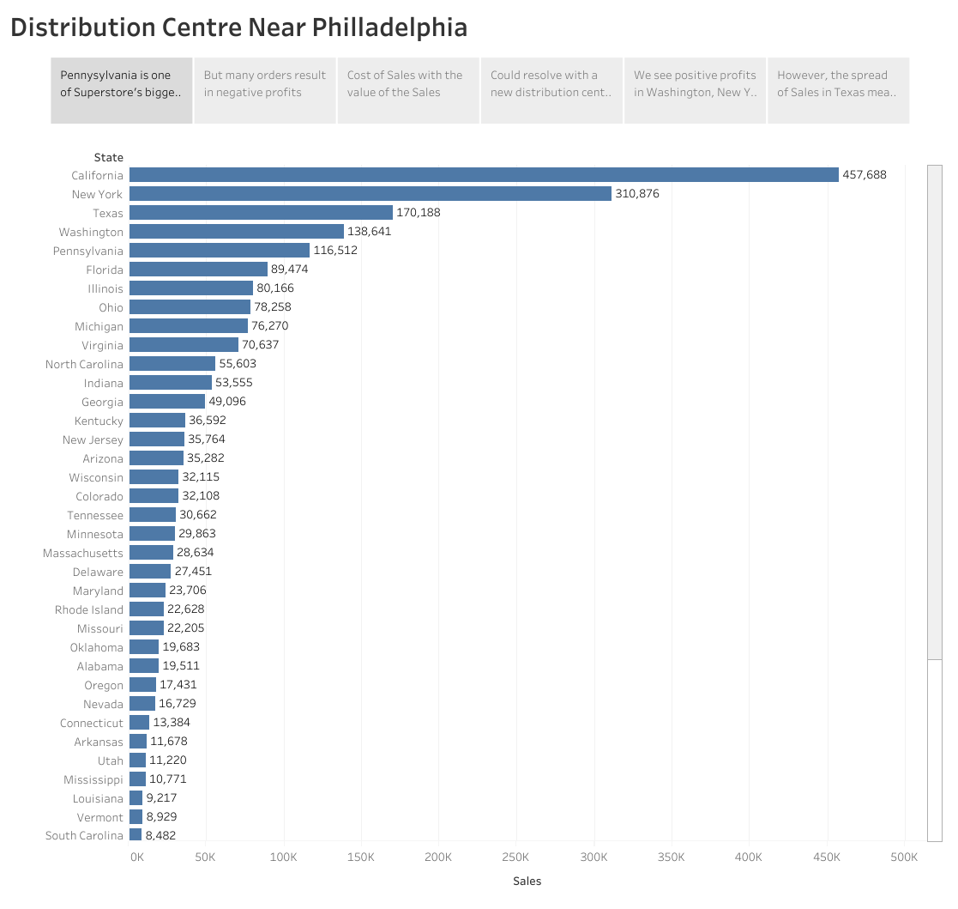

Slide 3
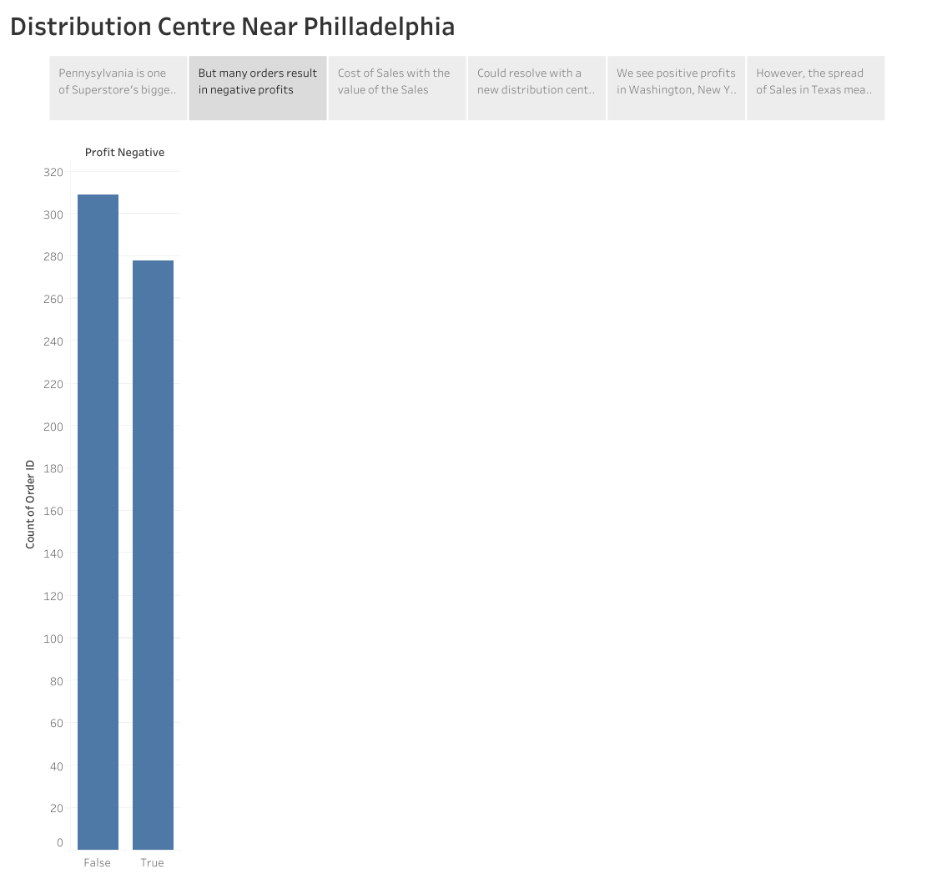

Slide 4
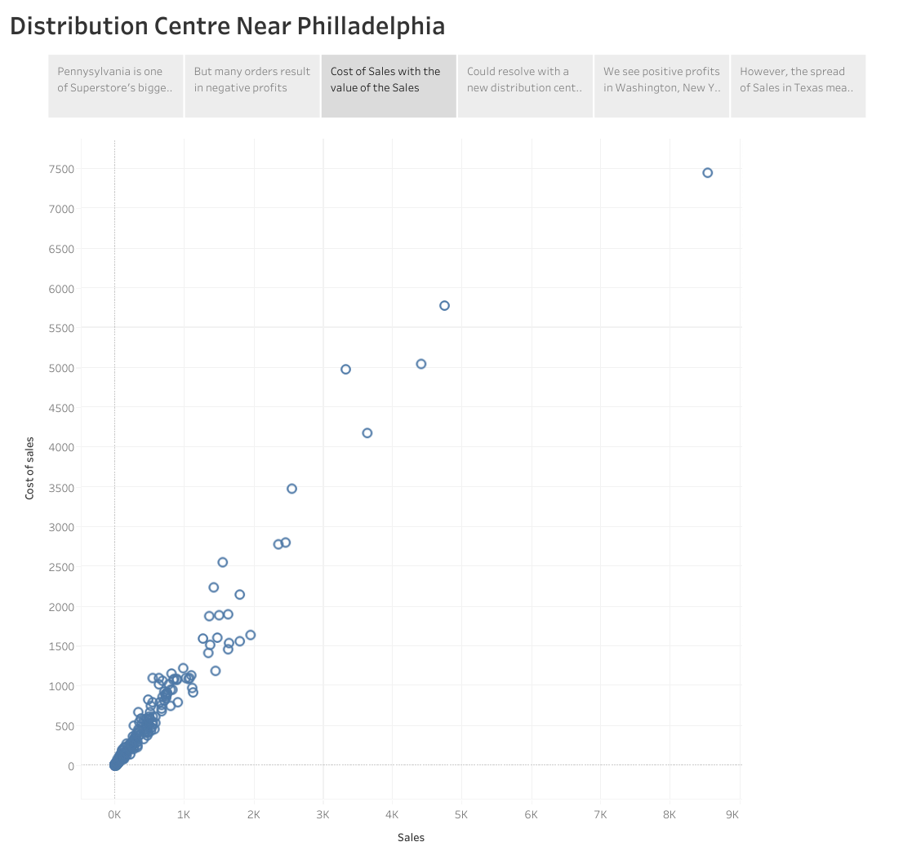

Slide 5
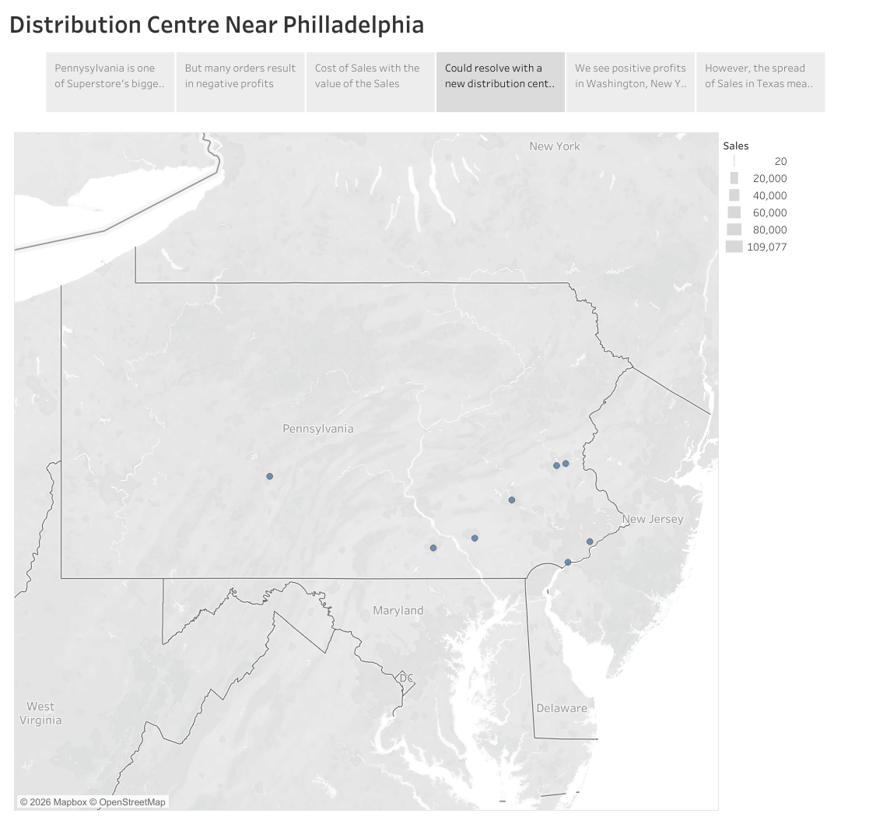

Slide 6
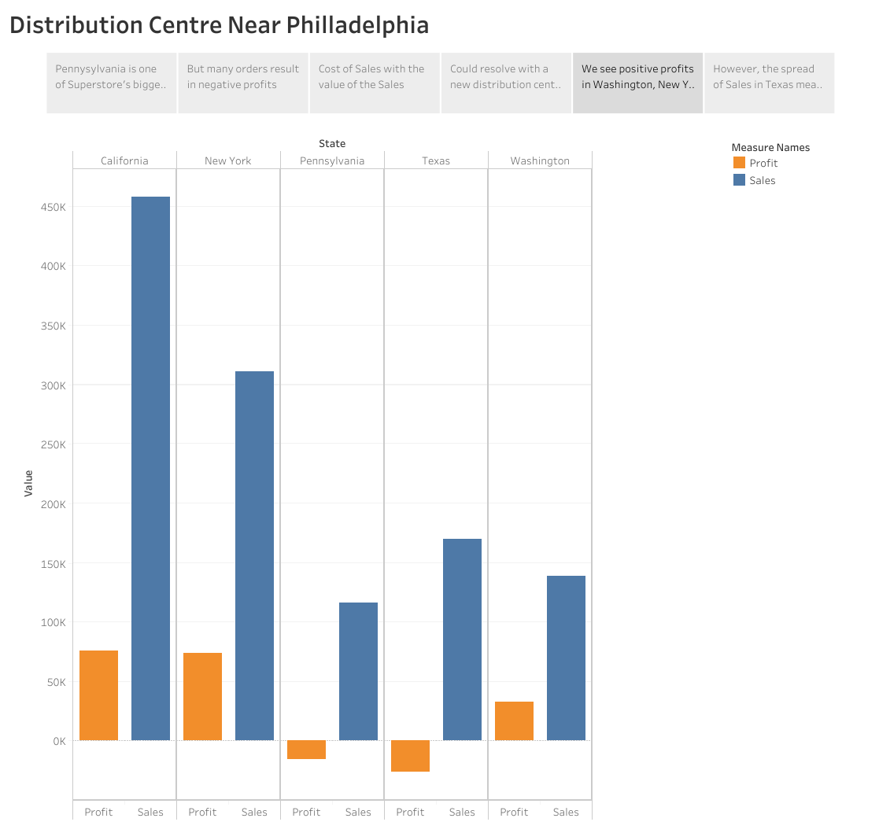

Slide 7
